Slide 1
Introduction to FHIR for Developers
HL7 Working Group Meeting
Atlanta, GA October, 2015
Brett Marquard

Slide 2
This presentation
Can be downloaded here:
http://gforge.hl7.org/svn/fhir/trunk/presentations/2015-10 Tutorials/
Use “anonymous” and email address to logon
Is licensed for use under the Creative Commons, specifically:
Creative Commons Attribution 3.0 Unported License
(Do with it as you wish, so long as you give credit)

Slide 3
Introduction
Notes:
Time start-10:00 (10 minutes)

Slide 4

Instructor
Brett Marquard
Principal, River Rock Associates
Extensive EHR experience
Primary Editor, Consolidated CDA
Primary Editor, Data Access Framework (DAF) FHIR IG
brett@riverrockassociates.com

Slide 5
Introduce ourselves
Show of hands:
HL7 (v2/v3) background?
How did you hear about FHIR?
Platform of choice (.NET, Java, Ruby, …)?
Familiar with HTTP, XML, JSON, REST?
Persistence technologies used?

Slide 6
Level Setting
Should be familiar with basics of FHIR – from Introduction to FHIR or equivalent presentation or experience
This presentation will drill a little deeper into FHIR messaging, documents, XML and JSON syntax, etc.
Will get through as much as we can . . .

Slide 7
Contents of this tutorial
Deconstructing FHIR
FHIR RESTful service interface
Resources in code
Break
Bundles, Search
Beyond REST
Inside the FHIR Distribution
This course uses FHIR version DSTU 2!
Notes:
[RS] This modified to match the actual section (also note here that the brochure Sept 2014 is wrong)
(RS – actual sections below. TODO update this slide.)
Introduction
Deconstructing FHIR
REST Interface
Resources in code
Break
Bundles
Search
Beyond REST
Inside the FHIR distro
Profiles and validation
Building a FHIR server
The End… is near

Slide 8
DSTU?
It’s a release/publication status
Draft Standard For Trial Use
Current version is DSTU2
Also called v1.0.1, Sept 2015
This course is based on DSTU2
Next version (unfinished) is DSTU2.1
January 2016 ballot
Publication TBD
So will this be all changed by DSTU2.1
Not really…
Notes:
[RS] This modified to match the actual section (also note here that the brochure Sept 2014 is wrong)
(RS – actual sections below. TODO update this slide.)
Introduction
Deconstructing FHIR
REST Interface
Resources in code
Break
Bundles
Search
Beyond REST
Inside the FHIR distro
Profiles and validation
Building a FHIR server
The End… is near

Slide 9
DSTU1 to DSTU2 changes
Principles unchaged
Mostly backwards compatible (non breaking)
LOTS of additions (that are beyond the core parts in scope of this course)
40+ new resources (think classes), some split, some combined, new attributes in existing resources
New operations (e.g. added merge patient, subscriptions to replace polling)
Renamed a few things (e.g. zip to postalCode), swapped an XML attribute to be an element (id), and…
Notes:
[RS] This modified to match the actual section (also note here that the brochure Sept 2014 is wrong)
(RS – actual sections below. TODO update this slide.)
Introduction
Deconstructing FHIR
REST Interface
Resources in code
Break
Bundles
Search
Beyond REST
Inside the FHIR distro
Profiles and validation
Building a FHIR server
The End… is near

Slide 10
DSTU2 changes
Change from “Atom” to “Bundle”
Full list of changes:
http://www.hl7.org/implement/standards/fhir/history.html
Includes list of breaking changes
Notes:
[RS] This modified to match the actual section (also note here that the brochure Sept 2014 is wrong)
(RS – actual sections below. TODO update this slide.)
Introduction
Deconstructing FHIR
REST Interface
Resources in code
Break
Bundles
Search
Beyond REST
Inside the FHIR distro
Profiles and validation
Building a FHIR server
The End… is near

Slide 11
What perspective?
v3
App
v2
FHIR
PHR
FHIR
Broker
Comm.
Interface
FHIR
DB
Notes:
You’re a message broker routing and translating between v2, v3 and FHIR
Your app interfaces with a PHR using FHIR natively
Your application can communicate using FHIR, but your software uses a proprietary RDBMS
[Use FHIR as the common language for a Vendor Neutral Archive – this is not pictured here but is ] [RS]
…Or a combination….
You might see data as a nested structure of XML, a series of tables with keys, class-diagrams….

Slide 12
Deconstructing FHIR
Looking at FHIR data modeling concepts from a software engineering perspective
Notes:
Time: 10:00-40:00 (30 minutes) [33 slides, 8 to 40]

Slide 13


Resources (review!)
“Resources” are:
Small logically discrete units of exchange
Defined behaviour and meaning
Known identity / location
Smallest unit of transaction
“of interest” to healthcare
V2: Sort of like Segments
V3: Sort of like CMETs

Slide 14

Structure of a Resource
Metadata
Resource
Narrative
Elements
Extensions
Extensions

Slide 15
Composition versus reference
FHIR makes composition and references explicit:
References are in between Resources. No context conduction across references – safe retrieval as individual resources.
Composition is within a Resource: Components have no meaning outside resource, no identity, no separate access path except through resource
Notes:
No context conduction: if a Condition resource references a particular Patient as it's subject, and it links to a Procedure resource as it's cause, there is no automatic rule or implication that the procedure has the same patient as it's subject.

Slide 16
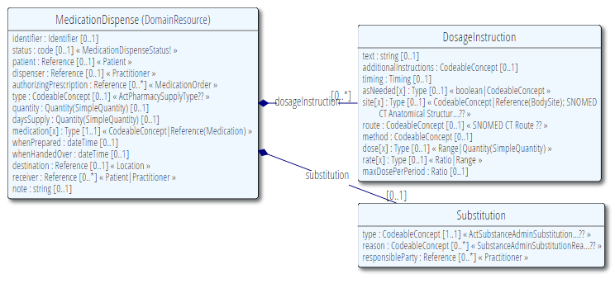

Composition of a Resource
Resource Root
Resource Component
Simple & Complex elements (may be repeating)
Notes:
Medication Dispense – the Resource root
Dispense & Substitution are components within Medication Dispense
Use of non-primitive “datatypes” / “value types”
[RS] Black diamond signifies Composition – these don’t have a life outside of the associated class.

Slide 17
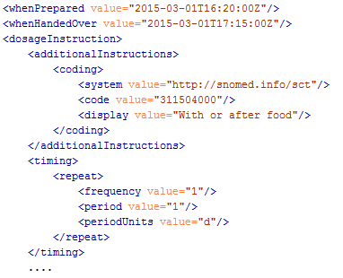
Composition

Slide 18
It’s all about combining resources . . .
http://lab.hospitalA.org/Observation/3ff27
http://pat.registry.org/Patient/223
Observation
Patient
Diagnostic
Report
http://lab.hospitalA.org/DiagRep/4445
Organization
http://hospitalA.org/Organization/1
Practitioner
http://hospitalA.org/Practitioner/87
Notes:
Diagnostic Report is the central resource here, that references the others, see next slide [RS]

Slide 19
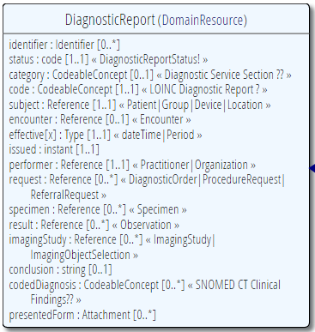
Diagnostic
Report
Patient
Practitioner
Observation
Notes:
References between resources are not by “business key”, it is *not* the patient id, it’s a REST URI!

Slide 20
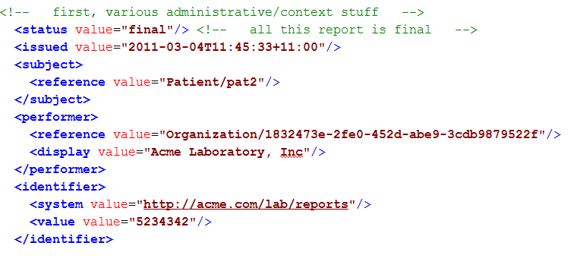
Resource Reference
Example: part of DiagnosticReport
Notes:
References between resources are not by “business key”, it is *not* the patient id, it’s a REST URI! [RS]

Slide 21

Resource Aggregate
“How do we know where an object
made up of other objects begins
and ends?”
“In any system with persistent storage
of data, there must be a scope for a
transaction that changes data and a way of maintaining the consistency of the data”
Notes:
Very important concept, comparable with the “Aggregate” notion of Domain Driven Design, for which many useful implementation strategies have been documented on the internet.
[RS] Aggregates are the basic element of transfer of data storage - you request to load or save whole aggregates. Transactions should not cross aggregate boundaries.

Slide 22
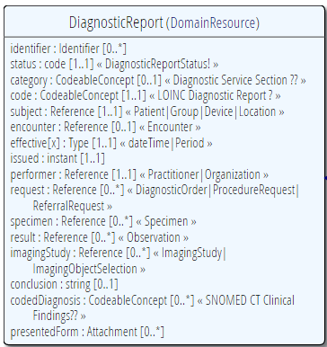
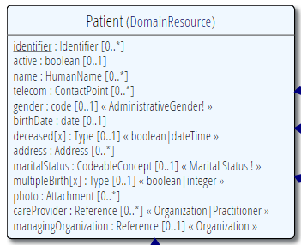
“Business” identifiers
Notes:
Resource Id’s (=URLs) are infrastructural id’s, they differ from “business” identifier.
Many Resources also have business identifiers, they are explicitly modeled, like Patient.identifier (even more than one identifier possible!)
Business identifiers are completely separate from technical resource id’s
The URL is the position of the resource and isn’t shown in the resource itself (metadata, see next slide) [RS]
Good to use words “Id” or “identifier” (even though those words are actually the same thing in most other contexts) [RS]

Slide 23
A Resource’s identity
In fact: an URL
http://server.org/fhir/Patient/1
resource type
endpoint
id
Note: This URL resolves to the current version of a resource
Notes:
This is not only the URL you use to retrieve the resource, it’s also its id.
All URL’s in FHIR are case-sensitive (and so is the id)
It is *metadata*, you won’t find this in the Resource’s definition

Slide 24
Resource metadata
Metadata
Patient
MRN 22234
“Ewout Kramer”
30-11-1972
Amsterdam
<id value="4705149-patient"/> <meta> <versionId value="4"/> <lastUpdated value="2015-08-10T16:18:46Z"/> </meta>
…
Notes:
Pink box is resource
Metadata has the ID, and history with version of 4
(core resource and stuff around the resource – yellow is no longer in HTTP, but in metadata) - http://hl7.org/fhir/taghttp://example.org/fhir/Status#Test
In Bundle there are eTAGS

Slide 25
The FHIR Elements
Complex
Datatypes (HumanName, Quantity, Period, Address, Identifier )
Constrained Types (Quantity: Distance, Count, Duration, Money)
Metadata
Resource
Narrative
use
Elements
use
Extensions
Extensions
Primitives (integer, boolean,
string, instant)
use
Derived Primitives
(oid, uuid, code, id)
Notes:
[RS] changed composite to complex
[RS – resources are user definable?] Only the Resources are user-definable, other types are “built-in”
Derived primitives are patterns -> validation consists of regexp matching
Constrained types are defined using invariants (OCL, Xpath, prose) -> validation using schematron, code
[RS] Narrative and Extension are both ONLY used in Resources
Resources can use both (derived) primitives and complex composite datatypes in its definitions
[RS] Infrastructural types need special handling, not general-purpose types

Slide 26
Start at the bottom: Primitives
boolean | xs:boolean | Values can be either true or false
integer | xs:int | A signed 32-bit integer
decimal | xs:decimal | A rational number. A true decimal, with inbuilt precision (e.g. Java BigDecimal)
base64Binary | xs:base64Binary | A stream of bytes, base64 encoded
instant | xs:dateTime | An instant in time - known at least to the second and always includes a timezone.
string | xs:string | A sequence of Unicode characters.
uri | xs:anyURI | A Uniform Resource Identifier Reference.
date | union of xs:date, xs:gYearMonth, xs:gYear | A date, or partial date as used in human communication. No time zone.
dateTime | union of xs:dateTime, xs:date, xs:gYearMonth, xs:gYear | A date, date-time or partial date as used in human communication. If hours and minutes are specified, a time zone must be populated.
Notes:
Now we will look at FHIR definitions from the bottom up, from datatype primitives, in several steps up to resources [RS]
The lexical rendering for these primitives in Xml is the same as in JSON (maybe this should go in the serialization section)
Expressing the allowed values in terms of XSD primitives brings in more variability then we would like. E.g. “0” and “1” are valid for xs:boolean. “+000004”, “4”, “+4” are all valid decimals.

Slide 27
Derived primitives
Using the ISO date/time with timezone
“1951”, “1951-06” and “1951-06-04”
“1951-06-04T10:57:34.0321+01”
“1951-06-04T10:57:34.0321Z”
Notes:
TODO: Search on timestamps (lower, upper bound), converting to zulu, user-timezone, sorting of times etc.
* Old-school types built on classis logic and math from the Greek, we have new stuff too…types based on urls!

Slide 28
Derived primitives
Based on uri(!): OID and UUID
urn:oid:1.2.3.4.5
urn:uuid:a5afddf4-e880-459b-876e-e4591b0acc11
Based on string:
code (string of characters, may contain single spaces) - “4548-4”, “active”, “not known”
id ([a-z0-9\-\.]{1,36})
Notes:
TODO: Search on timestamps (lower, upper bound), converting to zulu, user-timezone, sorting of times etc.
* Old-school types built on classis logic and math from the Greek, we have new stuff too…types based on urls!

Slide 29
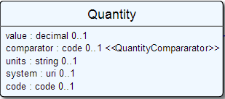
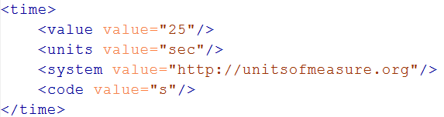
Level up: Complex Datatypes
Notes:
The content of a primitive is not rendered in XML as a text node but as an attribute
Notice how the “system” of a code is now a uri, so unlike in v3 an OID is now ALSO a uri (urn:oid:1.2.3.4.5)

Slide 30
Datatypes
Read more at:
http://www.hl7.org/implement/standards/fhir/datatypes.html
Notes:
Datatypes use both primitives and other datatypes.
Some datatypes use attributes with cardinality > 1
CodeableConcept.primary is actually refers to a coding in CodeableConcept.coding, so is not a code itself.
Quantity has constrained variations Distance, Count, Duration, Money. They introduce constraints on useable units, but do not add attributes, so not shown here.
Note that HumanId.assigner refers to a Resource

Slide 31
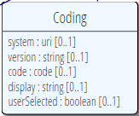

Coded types
Codes are defined in code systems
Notes:
CodeableConcept builds on Coding, which uses code [RS]
[Rik - This slide redone, CodeableConcept had extra attribute, also swapped the classes around. XML was using Problem which no longer exists]
Examples is from http://www.hl7.org/implement/standards/fhir/observation.htm
[RS] [removed bindings part, next slide]

Slide 32
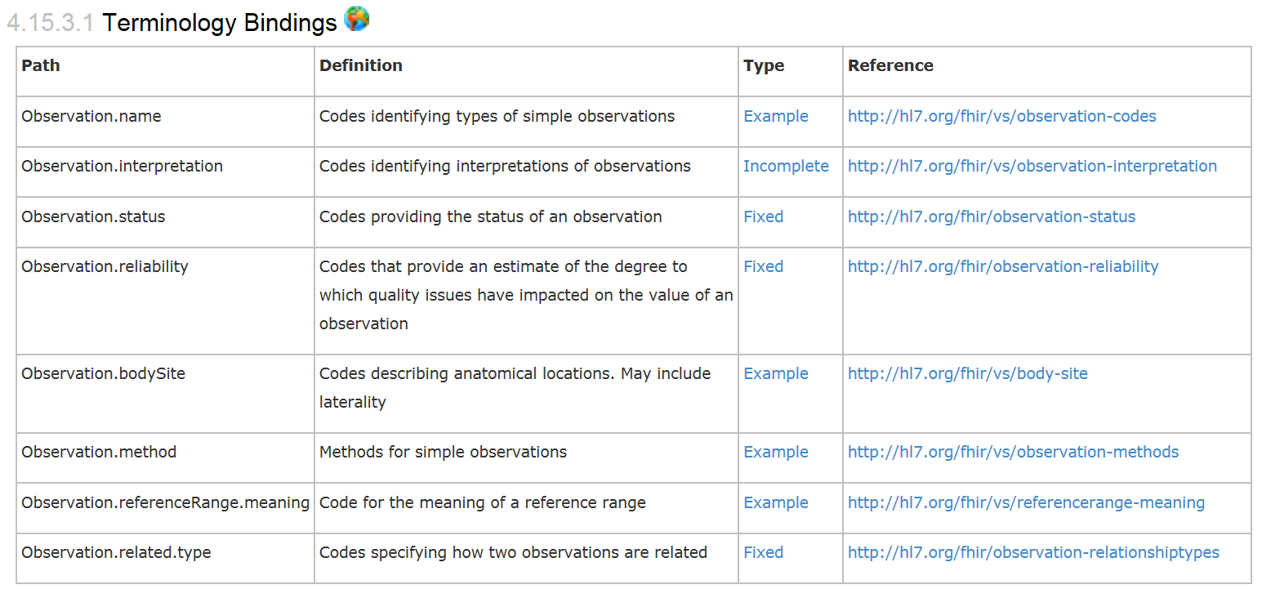
Coded types
When used in a Resource, the modelers include Bindings
Bindings specify which codes can be used
Notes:
Rik - Bindings are to value sets, as indicated by the “/vs/” in that path.

Slide 33
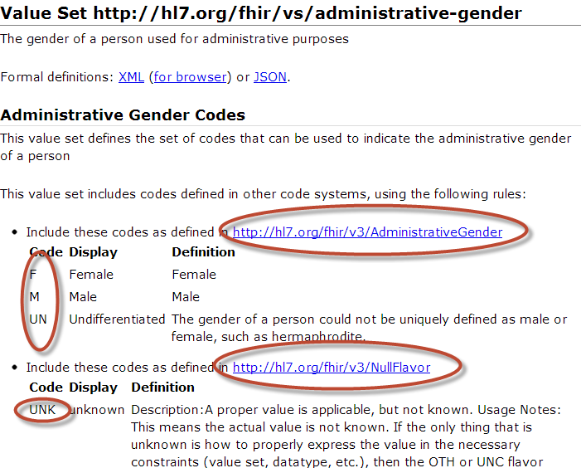
Notes:
Bindings use ValueSets to define what codes are allowed.
Patient.administrativeGender has a binding using the valueset “http://hl7.org/fhir/vs/administrative-gender”
This valueset includes codes from two code systems http://hl7.org/fhir/v3/AdministrativeGender and http://hl7.org/fhir/v3/NullFlavor
So yes, FHIR reused code systems from v3 (and v2), and has some defined specifically for FHIR.

Slide 34
Goto Some interesting valuesets to look at them
Notes:
[RS value set are at home->documentation->using terminologies -> value set list]
[RS value set resource is home->infrastructural resources->value sets]
[RS – probably skip this part, readers can browse on their own]

Slide 35
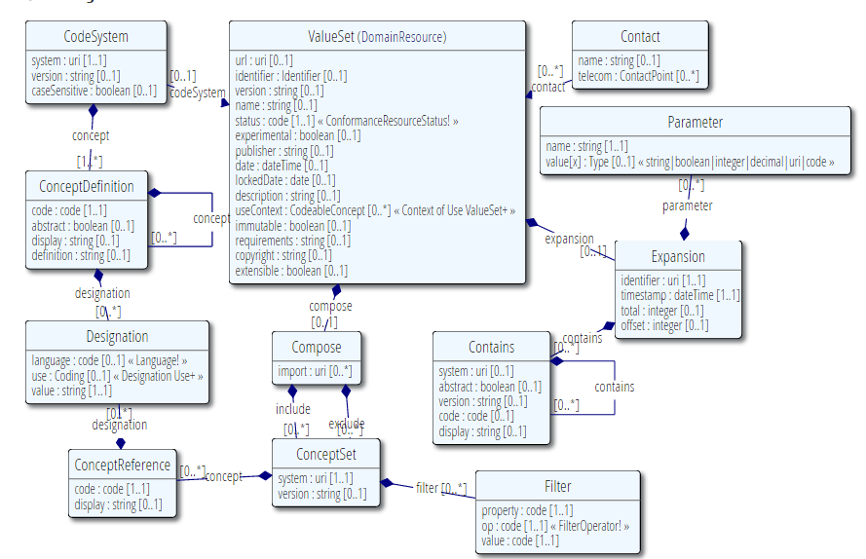
Value Set
Publication meta-data
Concepts from 1 or more existing systems
Additional concepts

Slide 36
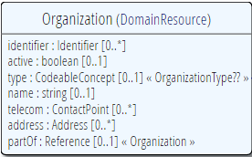
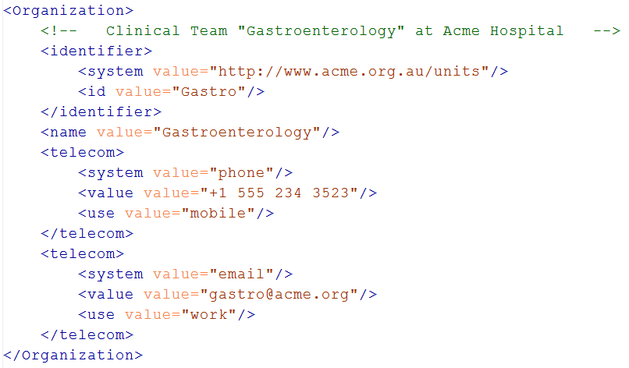
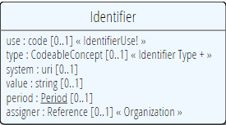
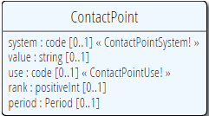
Level up: resources
Notes:
The element “identifier” is of type Identifier
The element “telecom” repeats, there is no notion of a “list” in Xml.
Empty elements are left out
Rik – Both Identifier and Contact are datatypes, of identifier and telecom respectively
Rik – somewhat confusing that Organization.telecom has a type of Contact, and there is also a component class in Organization called Contact.

Slide 37
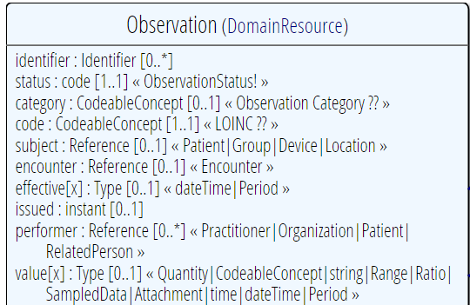
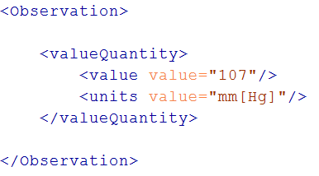
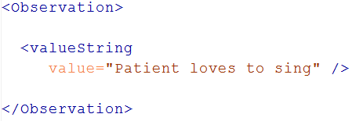
“Choice” properties
Notes:
* value[x] means: An element with a name that starts with “value”. The [x] is replaced by the (capitalized) name of the actual datatype

Slide 38
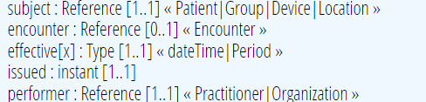
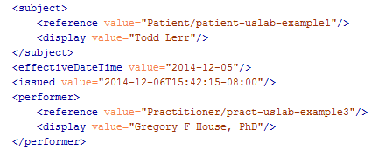
References
Notes:
There are references that can reference more than one type of resource! In this example: Resource(Patient | Group | Device)
The reference has a “type” element to indicate the kind of Resource that is referenced
References may be: Relative (on the same server), absolute URL (somewhere external) and internal (not treated here)

Slide 39
Quick look at extensions
Metadata
Resource
Narrative
Elements
Extensions
Extensions
Notes:
[RS think these notes are copied from slide 20]
Only the Resources are user-definable, other types are “built-in”
Derived primitives are patterns -> validation consists of regexp matching
Constrained types are defined using invariants (OCL, Xpath, prose) -> validation using schematron, code
Narrative and Extension are both ONLY used in Resources
Resources can use both (derived) primitives and composite datatypes in its definitions
Infrastructural types need special handling, not general-purpose types

Slide 40
Extensions
Patient
MRN 22234
“Ewout Kramer”
30-11-1972
Amsterdam
+ Haircolor BROWN
You can extend:
Resources
Elements of Resources
FHIR Datatypes
Organization “ACME Hospital”
National Drive 322
Orlando, FL
+ Taxoffice Id NLOB33233

Slide 41
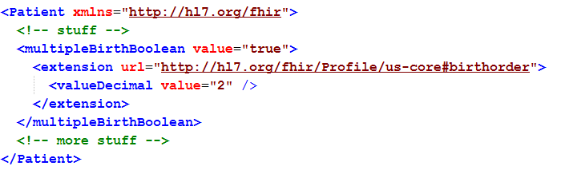
Extending a multiple birth
Key = location of formal definition
Value = value according to definition
Notes:
Really any FHIR element (Resource, Datatype, Primitive) can be extended. Just nest an <extension> element under the thing you want to extend
You should be able to go to the formal definition endpoint and get the definition of the extension.
Note: birth order is already provided for in FHIR through the multipleBirthInteger

Slide 42
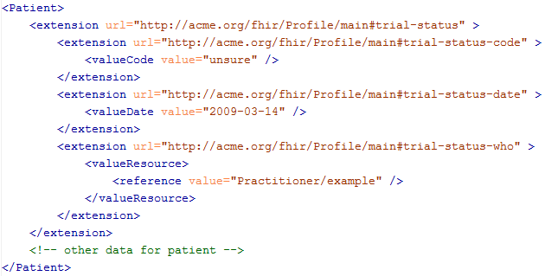
Complex extensions

Slide 43
Quick look at narrative
Metadata
Resource
Narrative
Elements
Extensions
Extensions

Slide 44
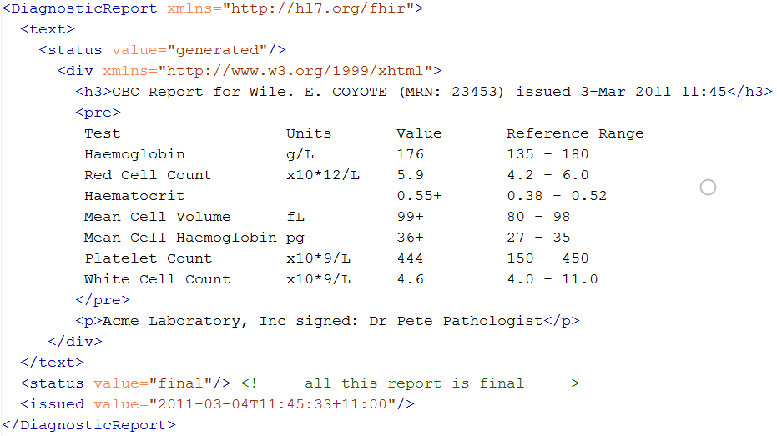
Narrative
Notes:
Resources SHOULD always contain narrative to support human-consumption as a fallback. However, in a strictly managed trading systems where all systems share a common data model and additional text is unnecessary or even a clinical safety risk, the narrative may be omitted.

Slide 45
REST service interface
How FHIR uses RESTful principles to communicate Resources
Notes:
Time: 0:50:00-1:30:00 (40 minutes) [26 slides, 41 to 66]
Rik - start at 14:20

Slide 46
Paradigms
FHIR supports 4 interoperability paradigms
REST
Documents
Messages
Services
REST
Notes:
* Content is the same

Slide 47
REST?
“REpresentational State Transfer”
Represent your data as “resources”
Make “Resources” URI addressable
Use HTTP to do CRUD operations
Resources may be exchanged using different representations

Slide 48
Possibly distributed…
FHIR server @ pat.registry.org
FHIR server @ lab.hospitalA.org
Patient/223
DiagnosticReport/4445
Observation/3ff27
Patient
subject
Observation
Diagnostic
Report
result
managing
performer
FHIR server @ hospitalA.org
Organization/1
Practitioner/87
Organization
Practitioner
Notes:
Rik – Start at the top right with the report

Slide 49
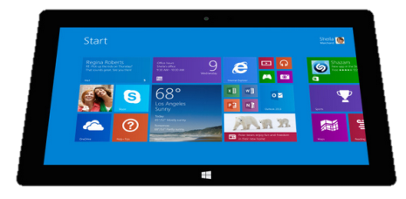

“Repository” model of healthcare
Hospital System
Lab System
Create
Update
Create
Update
Create
Update
Query
Query
Subscribe
FHIR server
Patient
Diagnostic
Report
Observation
Patient
Observation
Organization
Patient
Observation

Slide 50
Just a quick GET
GET /fhir/Patient/1 HTTP/1.1
HTTP/1.1 200 OK
Content-Type: application/xml+fhir;charset=utf-8
Content-Length: 787
Content-Location:
http://fhir.furore.com/fhir/Patient/1/_history/1
Last-Modified: Tue, 29 May 2012 23:45:32 GMT
HTTP Verb + path
UTF-8 encoded
<?xml version="1.0" encoding="UTF-8"?>
<Patient xmlns="http://hl7.org/fhir"><identifier><label>SSN</label><identifier><system>
http://hl7.org/fhir/sid/usssn</system><id>444222222</id></identifier></identifier><name><use>official</use><family>Everywoman</family><given>Eve</given></name><telecom><system>phone</system><value>555-555 2003</value><use>work</use></telecom><gender><system>http://hl7.org/fhir/sid/v2-0001</system>
<code>F</code></gender><birthDate>1973-05-31</birthDate><address><use>home</use><line>2222 Home Street</line></address><text><status>generated</status><div xmlns="http://www.w3.org/1999/xhtml">Everywoman, Eve. SSN:444222222</div></text></Patient>
Notes:
You can retrieve any person using a GET on the person’s id, which is just an url on the server: /fhir/Patient/<id>
We have our own MIME-type: “text/xml+fhir”
Note that FHIR always uses UTF-8. Since this is not the default for HTTP, the server explicitly mentions this
But should mean the xml encoding mentions “utf-8” and that the payload is really encoded in utf-8
There can be a Byte Order Mark, but hopefully your framework handles all that ;-) [RS this is an optional character string preceding a UTF-8 set of bytes, to say if little endian or big endian – which is actually irrelevant to UTF-8]
The response returns a Content-Location header with a version-specific location….see next slide 52 [RS]

Slide 51
A Resource’s REST identity
In fact: an URL
http://server.org/fhir/Patient/1
resource type
endpoint
id
Note: This URL resolves to the current version of a resource
Notes:
This is not only the URL you use to retrieve the resource, it’s also its id.
All URL’s in FHIR are case-sensitive (and so is the id)

Slide 52
Resource metadata
Metadata
Patient
MRN 22234
“Ewout Kramer”
30-11-1972
Amsterdam
<id value="4705149-patient"/> <meta> <versionId value="4"/> <lastUpdated value="2015-08-10T16:18:46Z"/> </meta>
…
Notes:
Pink box is resource
Metadata has the ID, and history with version of 4
(core resource and stuff around the resource – yellow is no longer in HTTP, but in metadata) - http://hl7.org/fhir/taghttp://example.org/fhir/Status#Test
In Bundle there are eTAGS

Slide 53
Tag metadata
GET /fhir/Patient/1 HTTP/1.1
HTTP/1.1 200 OK
Content-Location: http://sever.om/fhir/Patient/1/_history/12
Last-Modified: Tue, 29 May 2012 23:45:32 GMT
Category: http://example.org/fhir/Status#Test; scheme=" http://hl7.org/fhir/tag"; label="Our test tag"
http://hl7.org/fhir/tag | A general tag
http://hl7.org/fhir/tag/profile | A profile tag - a claim that the Resource conforms to the profile identified in the term
http://hl7.org/fhir/tag/security | A security label
Notes:
Just a quick look at tags, so the term had been mentioned

Slide 54
Mapping (meta)data to HTTP
Resource data
Resource id
Resource version
Last update date
http body
Url
ETag
Last-Modified header
Notes:
Note that the Version Id is considered a "weak" ETag and ETag headers should be prefixed with W/ and enclosed in quotes, for example: ETag: W/"3141"

Slide 55
One more look at the header
GET /fhir/Patient/1 HTTP/1.1
HTTP/1.1 200 OK
Content-Type: application/xml+fhir;charset=utf-8
Content-Length: 787
Content-Location: http://fhir.furore.com/fhir/Patient/1/_history/12
Last-Modified: Tue, 29 May 2012 23:45:32 GMT
Notes:
You can retrieve any person using a GET on the person’s id, which is just an url on the server: /fhir/person/@<id>
We have our own MIME-type: “text/xml+fhir”
Note that FHIR always uses UTF-8. Since this is not the default for HTTP, the server explicitly mentions this
But should mean the xml encoding mentions “utf-8” and that the payload is really encoded in utf-8
There can be a Byte Order Mark, but hopefully your framework handles all that ;-)
The response returns a Content-Location header with a version-specific location….see next slide

Slide 56
For a specific version…
We have the version-specific URL
http://server.org/fhir/ (continued)
Patient/1/_history/4
base path
resource type
identifier
version id
Notes:
Both the Resource id URL and the version-specific URL are used on many places of the REST spec and resource content (References!). They are always used consistently in this form.

Slide 57
Support for versions
33, v12 – 2012-12-04
/server.org/fhir/Patient/33/_history/12
33, v13 – 2012-12-05
/server.org/fhir/Patient/33/_history/13
33, v14 – 2012-12-08
/server.org/fhir/Patient/33/_history/14
33, v15 – 2012-12-09
/server.org/fhir/Patient/33/_history/15
/server.org/fhir/Patient/33
Notes:
* Note that you have two ways (at one moment) to reach version 15 [RS - What are these two?]

Slide 58
REST “representations”
GET /fhir/Patient/1?_format=json HTTP/1.1
HTTP/1.1 200 OK
Content-Type: application/json+fhir;charset=utf-8
Content-Length: 787
GET /fhir/Patient/1 HTTP/1.1
Accept: application/json+fhir
HTTP/1.1 200 OK
Content-Type: application/json+fhir;charset=utf-8
Content-Length: 787
Notes:
You can retrieve any patient using a GET on the patient’s id, which is just an url on the server: /fhir/Patient/<id>
We have our own MIME-type: “application/xml+fhir” and “application/json+fhir”

Slide 59
Question
DO I REALLY HAVE TO IMPLEMENT VERSIONS?
DO I REALLY NEED TO SUPPORT THAT PRE-HISTORIC XML STUFF?
NO, You are not required to keep history, and may return 410 (Gone) on a “vread” for any request for an older version than the current one!

Slide 60
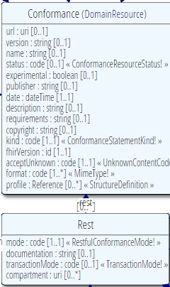
Conformance
Which FHIR version?
Which Resources?
What search operations?
What formats?
Is this a test server?
Who can I contact?
What’s the name of the software?
DO YOU SUPPORT HISTORY?
DO YOU SUPPORT XML/JSON?
http://www.hl7.org/fhir/conformance.htm

Slide 61
REST in the spec
Let’s look at these operations in the specification….

Slide 62
Mapping to verbs
create 2.1.10
The create interaction creates a new resource in a server assigned location. The create interaction is performed by an HTTP POST operation as shown:
POST [service-url]/[resourcetype] (?_format=mimeType)
read 2.1.6
The read interaction accesses the current contents of a resource. The interaction is performed by an HTTP GET operation as shown:
GET [service-url]/[resourcetype]/{id} (?_format=mimeType)
update 2.1.8
The update interaction creates a new current version for an existing resource or creates a new resource if no resource already exists for the given id. The update interaction is performed by an HTTP PUT operation as shown:
PUT [service-url]/[resourcetype]/{id} (?_format=mimeType)
delete 2.1.9
The delete interaction removes an existing resource. The interaction is performed by an HTTP DELETE operation as shown:
DELETE [service-url]/[resourcetype]/{id}
Notes:
Rik – these are section numbers from FHIR spec

Slide 63
To create a resource
You POST the contents to an url which indicates the resource type:
E.g. http://server.org/fhir/Patient
Supply body’s format in Content-Type header
Server returns 201 (Created).
Returns only the newly assigned version id URL in the Location header.

Slide 64
To update a resource
Use PUT on the resource’s URL, with the new contents in the body
Tell server the body’s format (xml/json) in the Content-Type header
Server returns 200 and the URL to new version in the Content-Location header.

Slide 65
Using PUT to create
Server might/might not allow you to PUT to an id that does not yet exist.
If it does: Server returns 201 and resource gets created at that location ➔ client determines resource’s id!
If it does not: server returns 405 (Method not allowed)
Notes:
- Whether server allows this depends on the level of trust between server and client: e.g. in-house scenario versus nation-wide network.

Slide 66
Version-aware updates
Server requires client to send Content-Location header with a version-specific URL
Server uses this to check whether you are updating the latest version.
Server will then return 409 (Conflict) if it has been updated by someone else in the meantime
Notes:
Behaviour depends on server configuration (and made public in a conformance statement).

Slide 67
What’s a ‘deleted’ Resource?
Trying read operations will return in a 410 (Gone) result instead of 404 (Not Found)
The resource will not be returned by the search operation
You can “undelete” by doing an update with fresh content
Just a “marker” in a resource’s history
Notes:
* the deletion operation should be understood as deleting the record of the resource, with nothing about the state of the real-world corresponding resource implied.

Slide 68
Version history - deletions
33, v12 – 2012-12-04
/server.org/fhir/Patient/33/_history/12
33, v13 – 2012-12-05
/server.org/fhir/Patient/33/_history/13
33, v14 – 2012-12-08
/server.org/fhir/Patient/33/_history/14
33, v15 – 2012-12-09
/server.org/fhir/Patient/33/_history/15
33, v16 – 2012-12-10
DELETION
/server.org/fhir/Patient/33/_history/16
/server.org/fhir/Patient/33
Notes:
* Now, if you query for /server.org/fhir/patient/33, you get a 410 [RS corrected note from @33, no longer using @]

Slide 69
Version history - revival
33, v13 – 2012-12-05
/server.org/fhir/Patient/33/_history/13
33, v14 – 2012-12-08
/server.org/fhir/Patient/33/_history/14
33, v15 – 2012-12-09
/server.org/fhir/Patient/33/_history/15
33, v16 – 2012-12-10
/server.org/fhir/Patient/33/_history/16
33, v17 – 2012-12-11
/server.org/fhir/Patient/33/_history/17
/server.org/fhir/Patient/33
Notes:
* The resource returns back to life!

Slide 70
Resources in code
How resources are made into classes in the supplied reference implementations
Notes:
Time: 40:00-50:00 (10 minutes) [7 slides, 67 to 73]
Rik - should start at 14:50, with break at 15:00

Slide 71
Reference implementations
Contents
Model – classes generated from the spec
Parsers – Parsers generated from the spec
Serializers – Serializers generated from the spec
FhirClient
Validation (currently Java only)
Java – Everything on the downloads page
.NET – NuGet “FHIR”, or GitHub “fhir-net-api”
Notes:
[RS]
NuGet syntax: Install-Package Hl7.Fhir –Pre
http://ewoutkramer.github.io/fhir-net-api/whats-new.html

Slide 72
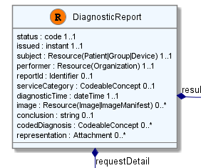
Object Model
[FhirResource("DiagnosticReport")]
public partial class DiagnosticReport : Resource
{
public Code<ObservationStatus> Status {…}
public Instant Issued {…}
public ResourceReference Subject {…}
public ResourceReference Performer {…}
public Identifier ReportId {… }
public
List<DiagnosticReportRequestDetailComponent> RequestDetail { …}

Slide 73
Parsing/Serializing using C#
// Create a file-based reader for Xml
XmlReader xr = XmlReader.Create(
new StreamReader(@"publish\observation-example.xml"));
// Parse the Observation from the stream
var obs = (Observation)FhirParser.ParseResource(xr);
// Modify some fields of the observation
obs.Status = Observation.ObservationStatus.Amended;
obs.Value = new Quantity() { Value = 40, Units = "g" };
// Serialize the in-memory observation to Json
var jsonText = FhirSerializer.SerializeResourceToJson(obs);

Slide 74
Parsing/Serializing using Java
XmlParser xml = new XmlParser();
Observation obs = (Observation)xml.parse(new FileInputStream(“observation.xml"));
obs.setStatusSimple(ObservationStatus.amended);
Quantity newValue = new Quantity();
newValue.setValueSimple(new BigDecimal(40)); newValue.setUnitsSimple("g");
obs.setValue( newValue );
ByteArrayOutputStream bos = new ByteArrayOutputStream();
JsonComposer comp = new JsonComposer();
comp.compose(bos, obs, true);
String json = bos.toString("UTF8");

Slide 75
Using FHIR Client in C#
var client = new FhirClient(
new Uri("http://fhir.com/svc/fhir"));
var patEntry = client.Read<Patient>("1");
var pat = patEntry.Resource;
var restId = patEntry.Id;
var tags = patEntry.Tags;
pat.Name.Add(HumanName.ForFamily("Kramer")
.WithGiven("Ewout"));
client.Update<Patient>(patEntry);

Slide 76
Using FHIR Client in Java
FHIRClient client = new FHIRSimpleClient();
client.initialize("http://spark.furore.com/fhir");
AtomEntry<Patient> pe = client.read(Patient.class, "1");
Patient p = pe.getResource();
HumanName hn = new HumanName();
hn.getFamily().add(Factory.newString_("Kramer"));
hn.getGiven().add(Factory.newString_("Ewout"));
p.getName().add(hn);
client.update(Patient.class, p, "1");

Slide 77
BUNDLES
Notes:
Time: 0:50:00-1:30:00 (40 minutes, 16 slides 74 to 89)
Rik - Start after break at 15:30

Slide 78
Communicating lists
We need to communicate lists of Resources
Search result
History
Documents or messages
Multiple-resource inserts (“batches”)
So, we need a way to represent lists, and a place to put our metadata

Slide 79

Bundles of Resources
Metadata
Metadata
Bundle
Resource
Resource
Narrative
Elements
Resource
Extensions
Extensions

Slide 80
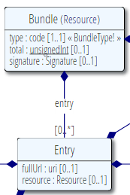
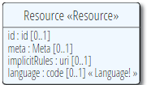
Base Resource
Bundle Resource

Slide 81
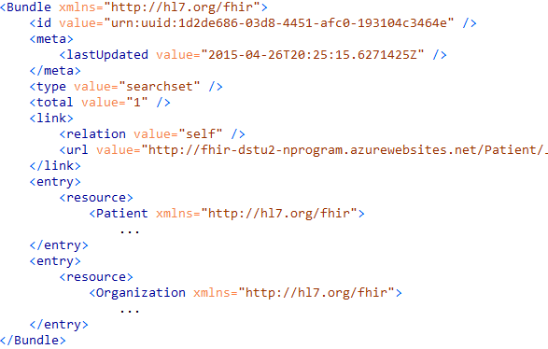
An example Bundle (in Bundle format – DSTU2)

Slide 82
Resource metadata
Metadata
Patient
MRN 22234
“Ewout Kramer”
30-11-1972
Amsterdam
<id value="4705149-patient"/> <meta> <versionId value="4"/> <lastUpdated value="2015-08-10T16:18:46Z"/>
<profile="http://hl7.org/fhir/daf/"/> </meta>
…

Slide 83
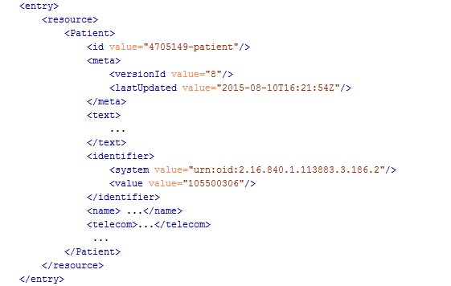
Resource Entry
Resource id
Meta
Human-readable form
Notes:
See how the resource meta-data is mapped to equivalent Atom members
Author is required by atom, so you’ll have to keep track who authored the resource, which might well be the user that POSTed it to your RESTful endpoint
Summary is optional, but it is easy to fill it with the Resource’s <text> (human readable narrative), so Feed readers have a way to display the contents of a resource. Yes, this means the summary is present twice in the entry.
All elements you see here are Atom spec, not FHIR

Slide 84
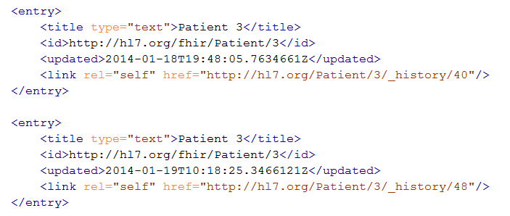
Multiple versions of entries
Same
id!
Notes:
Multiple versions are supported explicitly by Atom by having multiple entries with the same id, but a different ‘updated’ date
Notice how the ‘self’ links do differ, these are different versions after all.

Slide 85
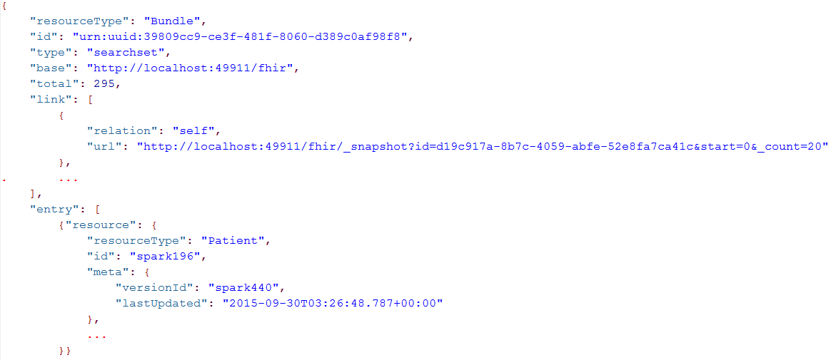
JSON Bundle - Example
Notes:
Just take a quick glimpse, it’s a pretty trivial translation of the Xml form to JSON, removing all needs for namespaces and attributes, and turning repeating elements into JSON arrays.

Slide 86
Bundles in C#
C# hides the processing of bundle
Bundle result = new Bundle() { Title = "Demo bundle" };
result.Entries.Add(new ResourceEntry<Patient>()
{ LastUpdated=DateTimeOffset.Now, Content = new Patient() });
result.Entries.Add(new DeletedEntry()
{ Id = new Uri("http://..."), When = DateTime.Now });
var bundleXml = FhirSerializer.SerializeBundleToXml(result);

Slide 87
Example: Keeping in sync
History of all resources on server
http://server.org/fhir/_history
History of all patient resources on server
http://server.org/fhir/Patient/_history
History of specific patient on server
http://server.org/fhir/Patient/1/_history
A history of all changes: updates and deletions, ordered by newest first
Limit with _since and _count
Notes:
[RS _since is used with _history]

Slide 88
SEARCH FUNCTIONALITY
And finally, the last REST operation (for now):
Notes:
Time: 1:30:00-1:50:00 (20 minutes) [9 slides, 90 to 98]
Rik – Start at 16:05

Slide 89
Getting “all” patients
http://server.org/fhir/Patient
Always returns a paged feed
Use _count to indicate number of results per page
Special case of the “real” search operation: http://server.org/fhir/Patient/_search?name=eve http://server.org/fhir/Patient?name=eve
Notes:
[RS] _search version is an alternative, and is documented in 2.1.11, under RESTful API
[RS] note search is case and accent insensitive (unless :exact is specified), and are “partial”. 2.2.2.4

Slide 90
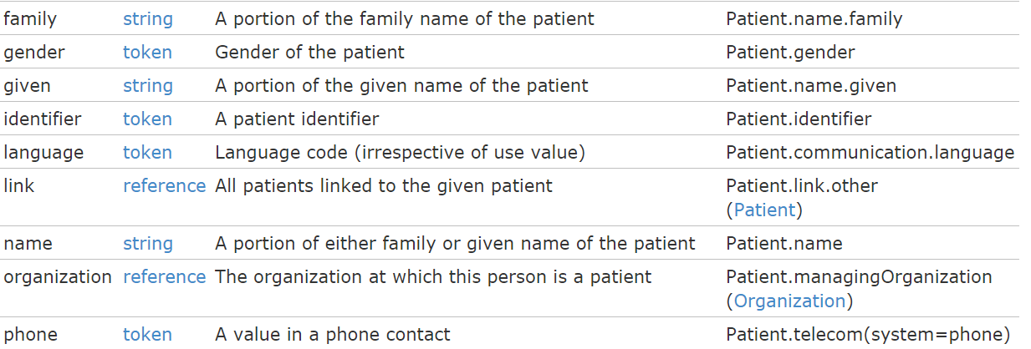
Search (patient)
Each resource has a set of “standard” search operations, so not every element can be searched!:
Our last search used this one

Slide 91
Combining parameters
Specifying multiple parameters finds resources matching all params ➔ “AND”
Parameters may list multiple values ➔ “OR”
http://server.org/fhir /Patient/search?
birthdate=1972-11-30
&language=NL,FR

Slide 92
Search (Patient)
Each search parameter has a ‘type’
Parameter
Type

Slide 93
Ok I get it…or not?
http://server.org/fhir/Patient/ 406 hits
http://server.org/fhir/Patient?gender=M 234 hits
http://server.org/fhir/Patient?gender=F 167 hits
Total: 234 + 167 = 401
http://server.org/fhir/Patient/ 406 hits
http://server.org/fhir/Patient?gender=M 234 hits
http://server.org/fhir/Patient?gender=F 167 hits
http://server.org/fhir/Patient?gender:missing=true 5 hits
Total: 234 + 167 + 5 = 406
Notes:
[RS] key here is that some are neither M nor F
[RS] Look at For more info see modifiers on the HL7 FHIR site (:exact, :missing, etc.) Search, 2.2.2.1

Slide 94
Chained searches
Patient has a search for “name”.
Observation has a search for “subject” (the id of the Patient, Group or Device)
How do I find Observations for a patient, searching using his name?

Slide 95
2 queries in 1
You (as a client) don’t need to do separate operations, just one:
http://server.com/fhir/Observation?patient .name=jones
But note: this still only works on the predefined search parameters. You cannot just use any property of the resource.

Slide 96
More optimizations
Say we do:
http://fhir.com/fhir/Observation?date=2014-01-20
We get back: a Bundle with 0..* “Observations”
Now, usually, wouldn’t we want the Patient information too? => Need to do “N” queries for the Observation’s “subject”
Quicker:
?_include=Observation:patient
Returns both Observations + Patients
Notes:
http://fhirtest.uhn.ca/baseDstu2/Observation?date=2015-10-13&_include=Observation:patient

Slide 97
Beyond REST
How FHIR supports messages and documents
Notes:
Time: 1:50:00-2:00:00 (10 minutes) [18 slides, 99 to 116]
Rik - Start 16:25

Slide 98
Paradigms
FHIR supports 4 interoperability paradigms
REST
Documents
Messages
Services

Slide 99
Regardless of paradigm
the content is the same
Receive a lab result in a message…
FHIR
Repository
FHIR Message
FHIR Document
Lab System
REST
National
Exchange
…Package it in a discharge summary document

Slide 100
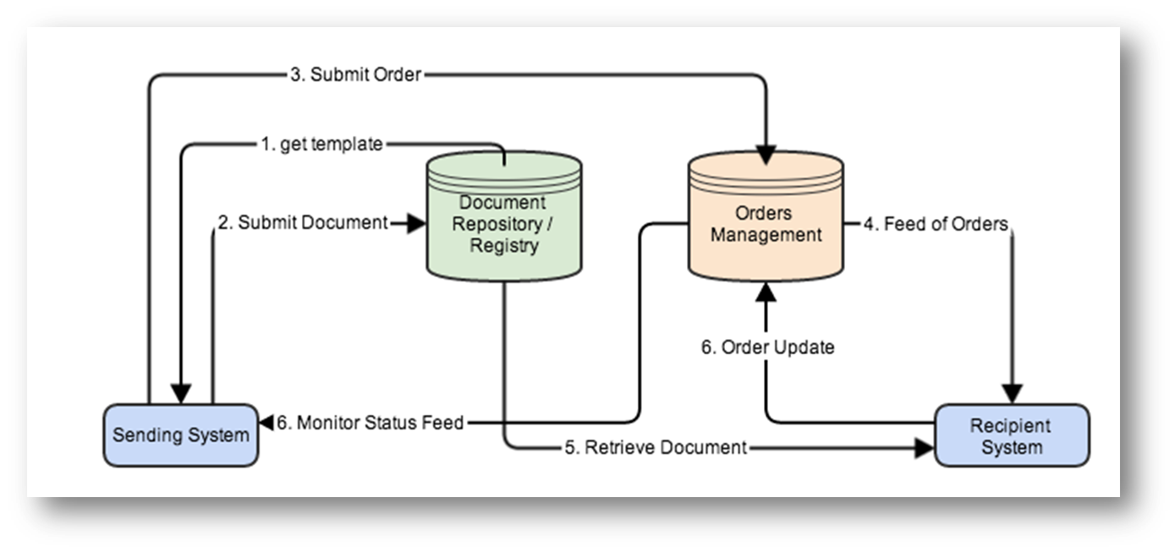

Slide 101
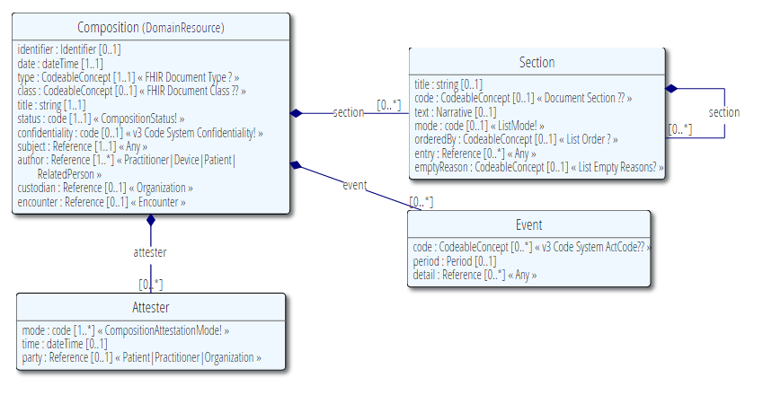
The Document resource

Slide 102
FHIR Document
Discharge
Summary Composition
Dr. Bernard Practitioner
Patient Mary Patient
author
subject
Kidney Stones Condition
Chief Complaint section
content
Pulse Observation
Vital Signs list
entry
Physical section
BP Observation
content
Medications section
Discharge Meds list
Dyclofenac MedicationPrescription
content
entry
Tamsulosin MedicationPrescription

Slide 103
Documents – are bundles
Composition Resource
<Bundle>
<entry>
<Composition />
</entry>
<entry>
<Observation />
</entry>
<entry>
<Device />
</entry>
<entry>
<List/>
</entry>
<entry>
<Condition/>
</entry>
</Bundle>
Metadata
Attester
Section
Section
Section
Observation Resource
Device Resource
List Resource
Condition Resource
Notes:
A Document, no matter how nested, is flattened to a list of entries, the Document’s header being the first.
The document header (and any other the other resources) refer to each other using normal references to reflect the document’s nesting.
Of course, there may be a digital signature (on the whole Bundle) to attest to the content of the document.

Slide 104
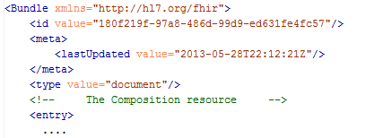
Bundle as “Document”
This Bundle is a Document
Notes:
[RS] Tags are http header “category”s

Slide 105
Communicating documents
You can store your document using
http://server.org/fhir/Composition
Others discussed in spec
Storage, NO disassembly is implied, document (and signature) stays intact
Search is supported (you search on it’s Message header – Composition)
Notes:
* But of course, some server could have functions to disassemble documents on reception. Since the contents of documents are resources, each of the contained resources (including the Document header) can be stored using the normal REST interface. But they are no longer the document anymore!

Slide 106
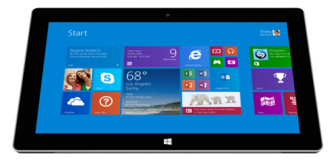
V3 and FHIR
CDA to FHIR Document bridge
FHIR Document processor
FHIR
Repository
FHIR
Documents
V3 CDA Documents
FHIR
REST
Hospital System A
Note: Documents are compositions,
No update semantics
Context?
Wholeness?

Slide 107
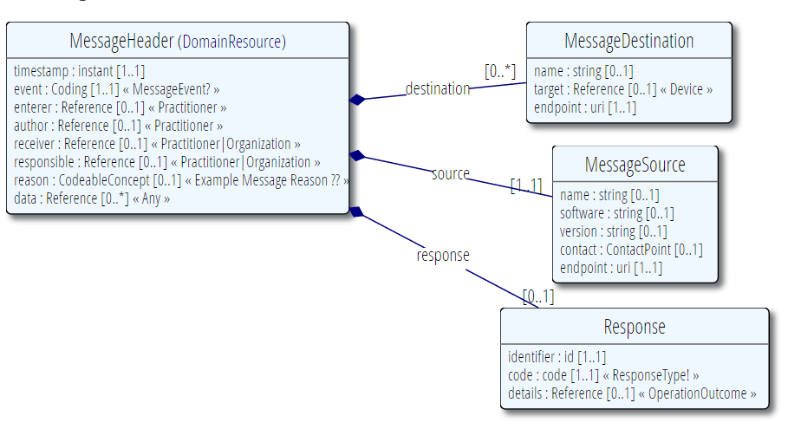
MessageHeader Resource

Slide 108
Messages – are bundles
<Bundle>
<entry>
<MessageHeader />
</entry>
<entry>
<Observation />
</entry>
<entry>
<Patient />
</entry>
<entry>
<Device />
</entry>
</Bundle>
MessageHeader Resource
source
destination
event
Observation Resource
Device Resource
Patient Resource
Notes:
A Message is similar, refers (amongst others) to its author, and contains information about the source, destination and the event that triggered it.
A message contains 1 “data” resource, which is the root of the payload of the message. This is just a normal resource, which in its turn can refer to other related resources.

Slide 109
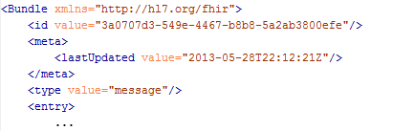
Bundle as “Message”
This Bundle is a Message

Slide 110
Sending messages
Again, REST not necessary, but…
There is an explicit REST operation:
[base]/$process-message
No storage implied. Might be a router, converted to v2, etc. etc.
The server can process them based on the event code and return the response as another message (again a bundle).
Notes:
* It’s the same drop-off point as for documents!

Slide 111
V2 and FHIR
V2 to FHIR bridge
FHIR Message processor
FHIR
Repository
FHIR
Messages
V2 Messages
FHIR
REST
Hospital System
Note: Messages are events,
REST exposes a “repository”
Model of data…

Slide 112
The Binary Endpoint
http://server.org/fhir/Binary/
Accepts any kind of content
Stores the content as is, along with the content type provided by the HTTP headers.
Acts just like the normal Resource endpoints (but there is no search)

Slide 113
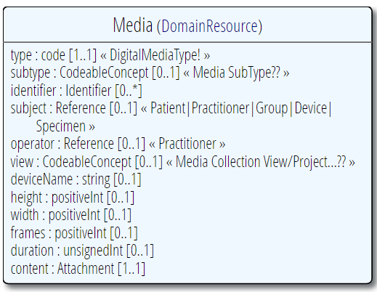
Useful for Attachments
/Binary/23344

Slide 114
INSIDE THE FHIR DISTRIBUTION
Notes:
Time: 2:25:00-2:35:00 (10 minutes) [9 slides, 117 to 125]
Rik – 16:35

Slide 115
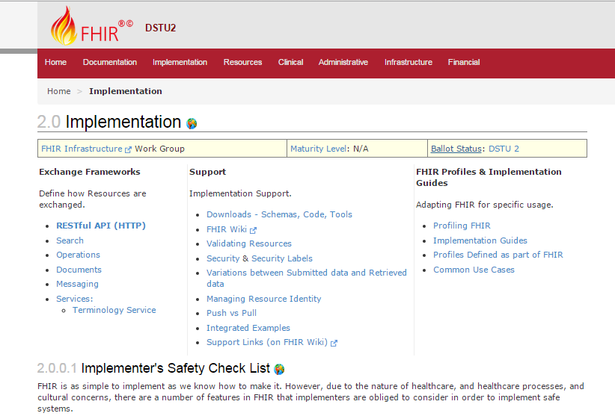

Slide 116
Browsing the site
REST API
Data Types
XML & JSON
Codes / Terminologies
Resource List
Stack Overflow
Public Test servers

Slide 117
The FHIR distribution
Under Implementation-Support-Downloads:
The XSD schemas / schematrons
The Java / C# / Delphi zips (model, serializers, parsers, etc, both code & binary)
All xml + json examples
Full spec for offline reading (always have your FHIR with you)
Note! .NET implementation has moved to GitHub, distribution by NuGet (.NET) and Maven (Java)

Slide 118
In the FHIR SVN
All you need to build FHIR (/build)
All presentations (/presentations)
Source of the publication process (/build/tools, we use Eclipse + Java 1.6)
Archived older versions of FHIR (/archive)
You can download only the /build
Then run publish.bat & wait
Notes:
[RS]
You do need ANT installed, for windows at least.
Publish = build. It builds what gets published.

Slide 119
The FHIR SVN
The “build” SVN tree, the “full” SVN tree
http://gforge.hl7.org/svn/fhir
User ‘anonymous’, blank password
Note: you have to run the publisher to be able to build the C# and Delphi source. Without that…they won’t compile!

Slide 120
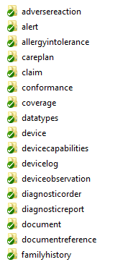
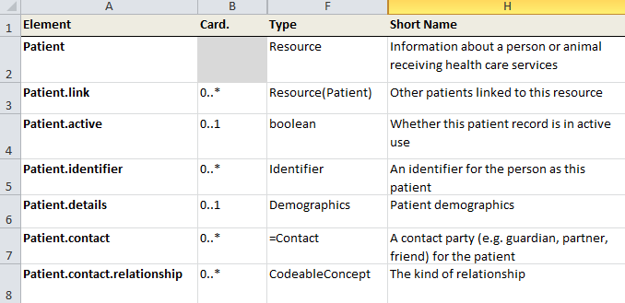
“Source” of FHIR
Straight from the HL7 SVN “code” repository
at gforge.hl7.org

Slide 121


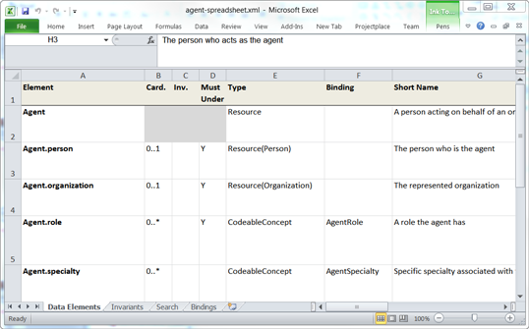

Publication process
.INI
examples
Publication tool
(org.hl7.fhir.tools.jar)
Website
Examples
Resource
UML
Java, C#,
Delphi
Validation
Schemas
DictXml
Resource profiles
eCoreDefinitions.xml

Slide 122
Generator writers!
There’s a file called eCoreDefinitions.xml that the C# generator runs of. It has all details from the definitions
There are Profiles for each resource, basically describing the “unconstrained” resources

Slide 123
Profiles and validation
Short introduction to
Notes:
Time: 40:00-50:00 (10 minutes) [9 slides, 126 to 134]
Rik – 16:45

Slide 124
The need for Profiles
Many different contexts in healthcare, but a single set of Resources
Need to be able to describe restrictions based on use and context
Allow for these usage statements to be:
Authored in a structured manner
Published in a repository
Used as the basis for validation, code, report and UI generation.
Notes:
[RS] added “to be:” on third bullet

Slide 125
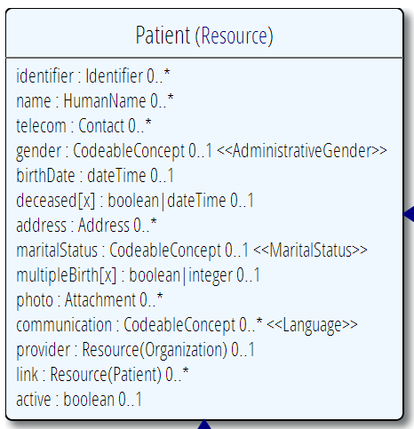
Constraining cardinality
Limit cardinality to 1..2
(e.g. to at maximum your organizations’ identifier + the national one)
1..2
1..1
0..0
Limit names to just 1 (instead of 0..*)
Forbid any telecom elements
Note: something that’s mandatory in the core definition cannot be made optional in a profile

Slide 126
Limit value domains
If deceased is given, it must be a dateTime, not a boolean
Use our national codes for MaritalStatus
OrganizationNL
=“true”
Use another profiled Resource
Fix value: Only allow “active” Patients

Slide 127
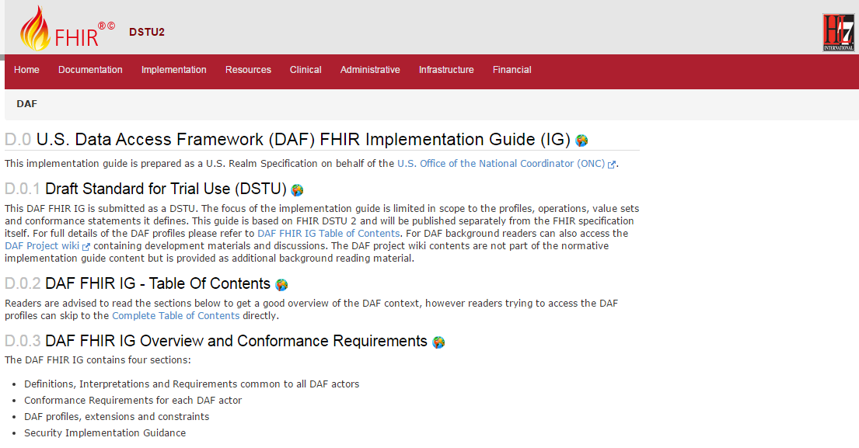
Data Access Framework
http://hl7.org/fhir/daf/daf.html

Slide 128
Tagging a Resource
Patient
MRN 22234
“Ewout Kramer”
30-11-1972
Amsterdam
http://hl7.org/fhir/tag/security
“I’m a VIP - My information cannot yet be disclosed”
http://hl7.org/fhir/tag “This is TEST data! Don’t use!”
http://hl7.org/fhir/tag/profile “I’m a Patient as defined in the Norwegian Profile – see http://hl7.no/Profiles/patient-no”

Slide 129
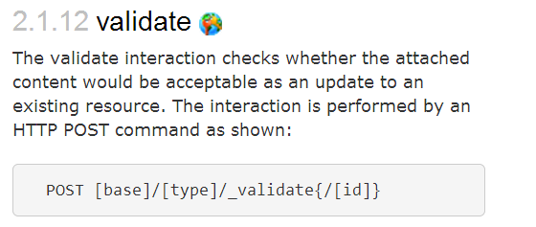
Validation

Slide 130
Validation
When receiving an XML resource
1. Validate using schema
2. Run schematrons
When receiving JSON
1. Parse the JSON
2. Serialize to XML
3. Validate using schema
4. Run schematrons
There’s a validation pack for Java

Slide 131
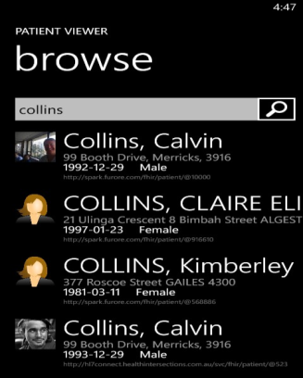
(Distributed) validation
App’s server
Profile X
Profile Y
Store &
Validate
Country validation server
Profile X
Validate Y
Profile Y
Download & Validate
Profile Y
Notes:
A server might defer validation to another server (because it doesn’t know the profile)
A server may fetch the “unknown” profile and validate it itself
There may be several servers sharing the work

Slide 132
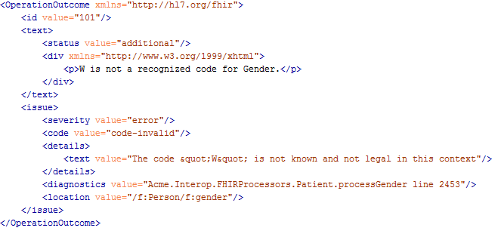
Operation Outcome
When something goes wrong….return the OperationOutcome Resource!

Slide 133
Building a fhir server
FHIR in practice
Notes:
Time: 2:35:00-2:55:00 (20 minutes)

Slide 134
Some possible uses
v3
App
v2
FHIR
PHR
FHIR
Broker
Comm.
Interface
FHIR
DB
Notes:
You’re a message broker routing and translating between v2, v3 and FHIR
Your app interfaces with a PHR using FHIR natively
Your application can communicate using FHIR, but your software uses a proprietary RDBMS
Use FHIR as the common language for a Vendor Neutral Archive
…Or a combination….
You might see data as a nested structure of XML, a series of tables with keys, class-diagrams….

Slide 135
Repository model
HIS
LIMS
PACS
SystemX
Gateway
FHIR
FHIR
FHIR
FHIR
FHIR
Vendor Neutral Repository

Slide 136
Overview of a server
HTTP / REST interface
Encoding/decoding, param validation, syntax validation
Implement service operations as described in spec
Fhir Service
Indexer / Search
Storage

Slide 137
From wire to store
REST interface
JSON/XML
JSON/XML
JSON/XML
FHIR Parser
FHIR Parser
FHIR Parser
Fhir Service
POCO/POJO
POCO/POJO
POCO/POJO
O-R Map
Serialize
Serialize
Storage
NoSql (Xml/Json)
DBMS
DBMS
Notes:
First scenario is most common for existing databases: you have to map the FHIR structure (as POCO’s) onto your (existing) databases tables. Lot’s of mappings to support our nesting, cardinalities, datatypes
Second scenario uses the parsers to create POCO’s then use a NoSql driver’s serialization possibilities to store the structure-as-is in NoSql
Third scenario uses POCO’s and DBMS, but instead of mapping FHIR to tables, stores the data as-is into blob storage in a DBMS

Slide 138
Briefest intro to JSON
JSON (“JavaScript Object Notation”): it’s JavaScript, not markup!
{ “Country" : { “name" : “the Netherlands", “population" : 16696000,
“popDensity” : 447.9
}
}
var report = eval(“({…})”); alert(report.LabReport.status);
Very easy parsing for JavaScript clients. But actually, use JSON.parse() instead ;-)

Slide 139
Xml and JSON are different
Xml
JSON
<XXX xmlns=“urn:foo”>
<B a=“c” />
<C>One</C>
<C>Two</C>
<D>One</D>
<div>Not <b>so</b> easy</div>
</XXX>
{ “B”: { “a” : “c” },
“C”: [ “One”, “Two” ],
“D” : “One”,
“div” : {
“text-before”:“Not ”,
b:“so”,
“tekst-after”:“easy”}
}
How to retain namespaces?
How do you identify attributes?
Bridge difference in datatypes?
Distinguish single elements from lists with one element?
Mixed content?
Notes:
We tried to find a way to automatically convert between the two so you could round-trip…
But discovered you’d need additional metadata to do that, or vendor-specific solutions
Decided not to introduce these: result was weird Xml or weird Json
Reference platform contains tools to interconvert (these use model definition metadata)

Slide 140

Xml and JSON in FHIR
code.coding is 0..*

Slide 141

Xml and JSON in FHIR

Slide 142
Handling both
You need “meta” knowledge of the definition to distinguish lists / attributes
The Java/C# API’s can easily interconvert
Digital Signatures (in json?) are a problem when converting → store the original
JAXB / XmlSerializer / DataContract would need extensive customization / additional @annotation / [attributes]. Contact us!

Slide 143
Document-oriented store
A document-oriented store can store Resources as a “whole” document.
E.g. MongoDb stores documents in JSON:
post = { author: “mike”,
text: “my blog post...”,
tags: [“mongodb”,“intro”] };
db.posts.save( post );
db.posts.find( { author: “mike” } );
db.posts.find().sort({date: -1}).limit(10);

Slide 144


Slide 145


No (sql) transactions

Slide 146
Batch: needs transactions
Transaction
The transaction interaction submits a set of resources to be updated, created or deleted on the server. This interaction allows multiple resources to be updated/created in a single transaction. The interaction is performed by an HTTP POST command as shown:
POST [service-url] (?_format=mimeType)
The content of the post submission is a resource bundle.

Slide 147
Storing resources
FHIR POCO Model
Mongo
Patient
Atom Entry
(stored json)
Resource
Binary
Observation
Amazon S3
Metadata
Binary
Original
(json or xml)
Notes:
You might have to keep the original (as you received it on the service interface), for attestation/digital signatures
Store the binaries in another location (e.g. Amazon S3, filesystem) and just keep the URL here.

Slide 148
RDBMS: BLOB + Index
Id | ResourceId | VersionId | LastUpdate | Contents
1 | 1 | 1 | 2012-12-19 | <Patient …>
2 | 1 | 2 | 2012-12-20 | <Patient …>
3 | 2 | 1 | 2012-12-20 | <Observation …>
Id | Param | Value | System
2 | Patient.Name | “Ewout”
2 | Patient.DoB | “1972-11-30”
3 | Obs.Code | “234332” | SNOMED
Separate tables for current and history?
Type | VersionIdHigh
Patient | 2
Lab | 3
Need to index only latest version!

Slide 149
Both implementations use a separately maintained index for search?
Yes, here’s why…

Slide 150

Predictable search
Each resource has a fixed set of search parameters:
Searched element
Parameter
Type

Slide 151
Types of parameters
integer | Search parameter must be a simple whole number.
string | Search parameter is a simple string, like a name part. Search is case-insensitive and accent-insensitive. May match just the start of a string.
date | Search for an exact match on a date (parameters look like 1956-05-27T12:34:12+04:00 or shorter)
token | Search parameter on a coded element or identifier. May be used to search through the text, displayname, code and code/codesystem (for codes) and label, system and key (for identifier).
reference | A pair of resource type and resource id, separated by "/". Matches when the resource reference resolves to a resource of the given type and id.
Note: you need to escape the query-string!!

Slide 152
Partial/combined match
The search parameter description shows that the match certainly isn’t always exact, and can even combine the contents of several elements:
Name / Type | Description
address : string | an address in any kind of address/part of the patient
family : string | a portion of the family name of the patient
given : string | a portion of the given name of the patient
name : string | a portion of either family or given name of the patient
phonetic : string | a portion of either family or given name using some kind of phonetic matching algorithm

Slide 153

Prepare your data!
patient/search? name=johan& name=grafin& telecom=5552004
“Groom” – prepare for searching

Slide 154
The end is near…
Notes:
Time: 10:00-35:00 (25 minutes)

Slide 155
Balloting plans
Second Draft Standard for Trial Use ballot (DSTU) complete
FHIR is now published as a DSTU
Will provide a semi-stable platform for implementers while still allowing non-backward-compatible change for Normative version if implementation experience dictates
Additional DSTU versions every 1.5-2 years to make fixes, introduce new resources
Normative is around 2 years out
We want *lots* of implementation experience before committing to backward compatibility

Slide 156

Next Steps for you
Read the spec: http://hl7.org/fhir
Try implementing it
Come to a Connectathon!
fhir@lists.hl7.org
#FHIR
Implementor’s Skype Channel
StackOverflow: hl7 fhir tag

Slide 157
Thank You - QUESTIONS?
Notes:
[RS – added thank you]

